Slide 1
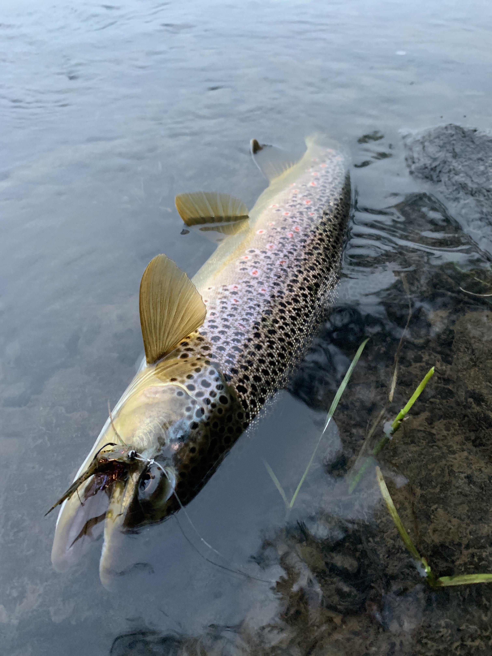
Fishing Report Sentiment Analysis
Presented by: Anthony Marsilio
May 9th, 2023

Slide 2
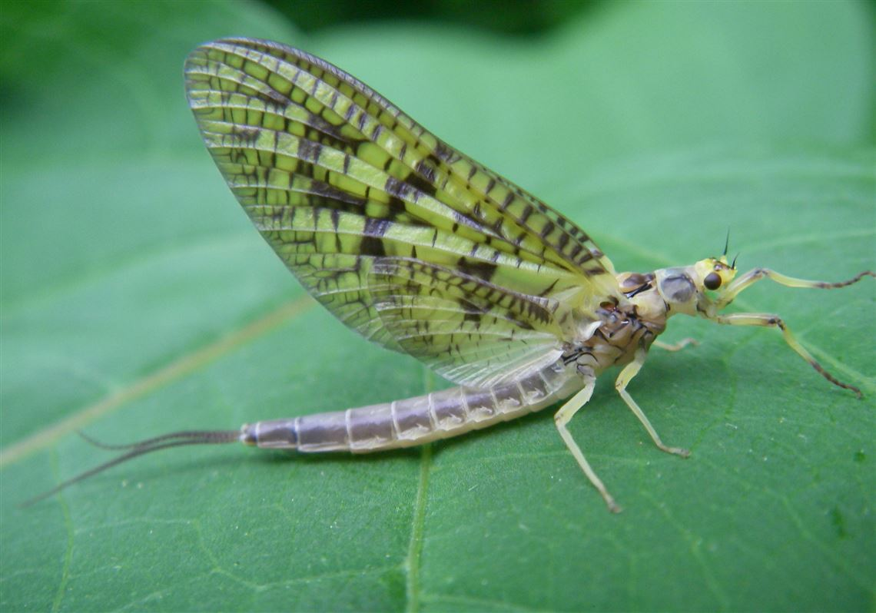
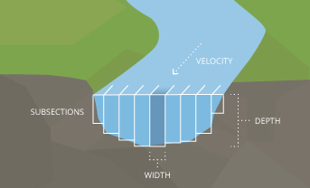
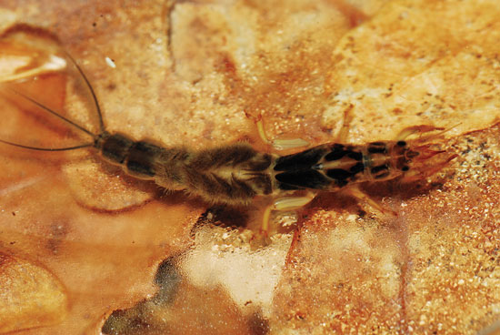
Definitions:
Streamflow
(Cubic Feet per Second)
Aquatic Insect

Slide 3
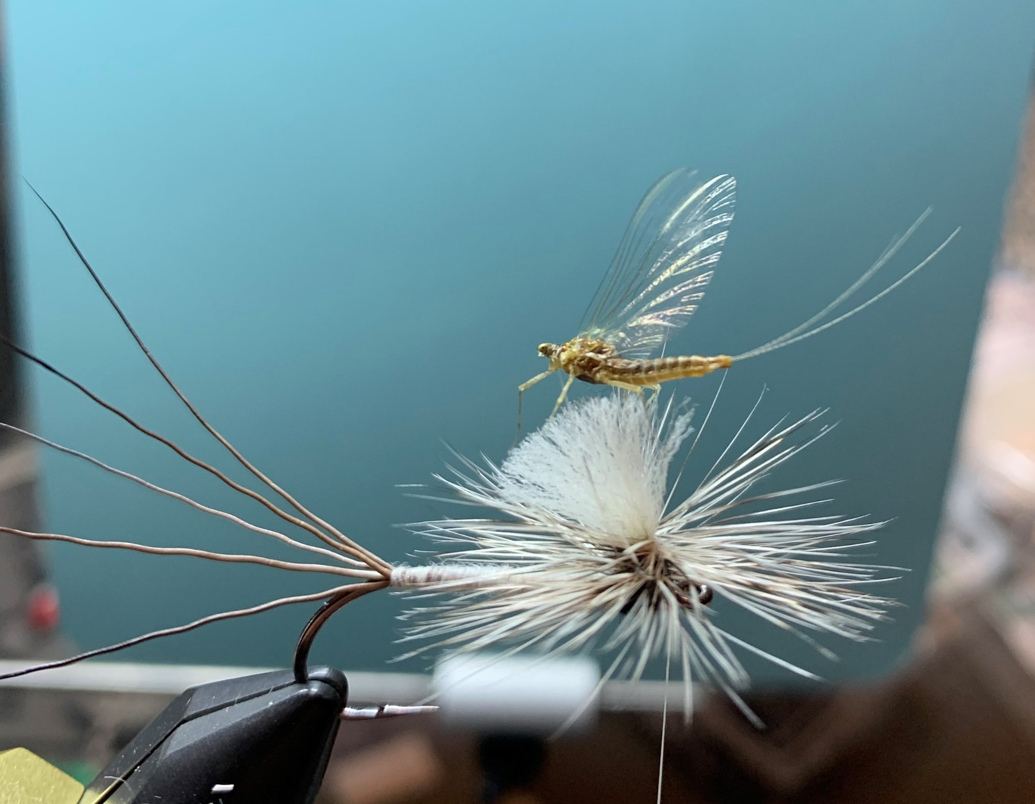
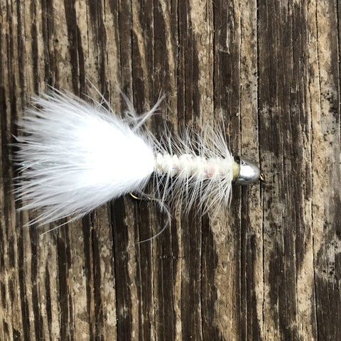
Definitions:
“Flies” and Forage

Slide 4
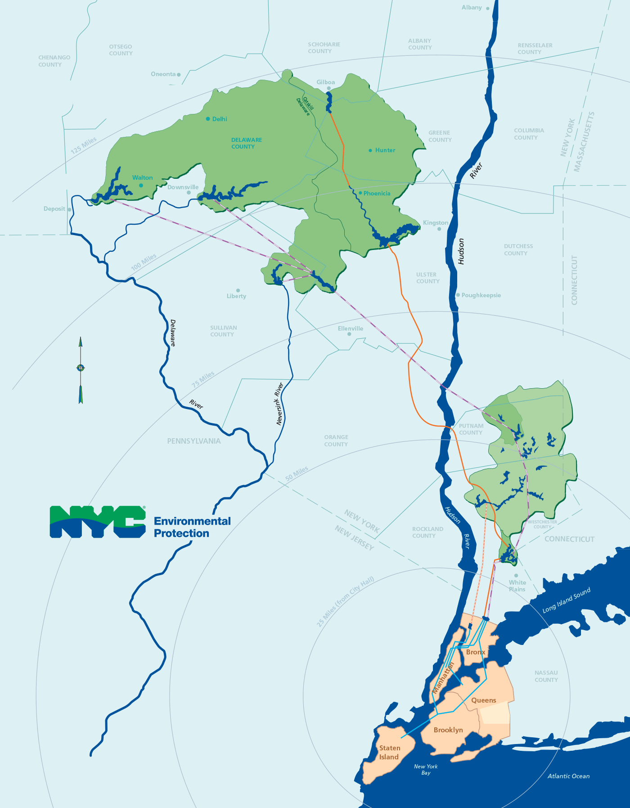
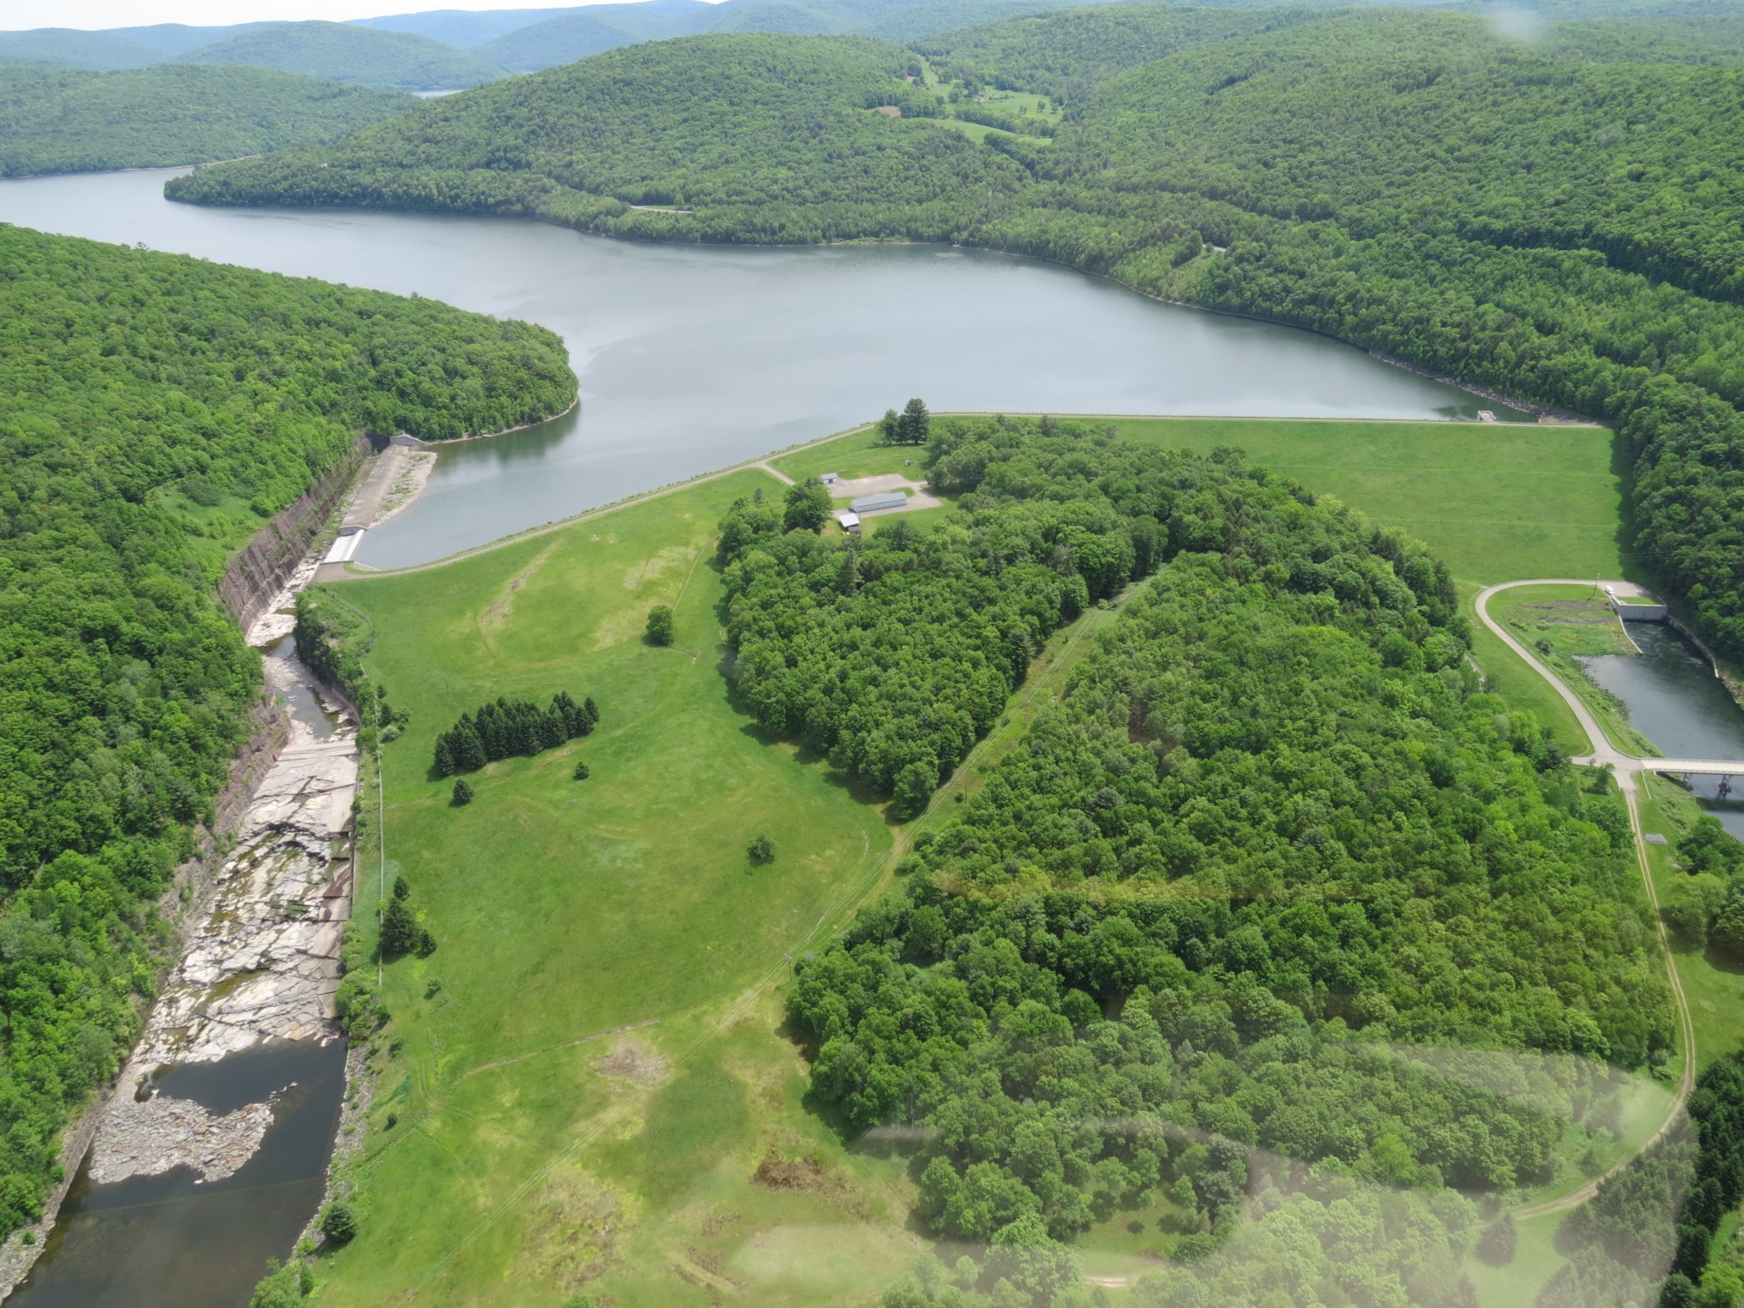
Context:
New York’s Water
Cannonsville Resevoir

Slide 5
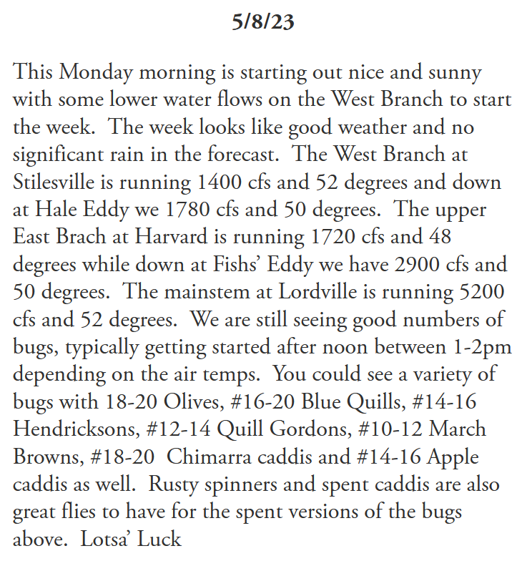
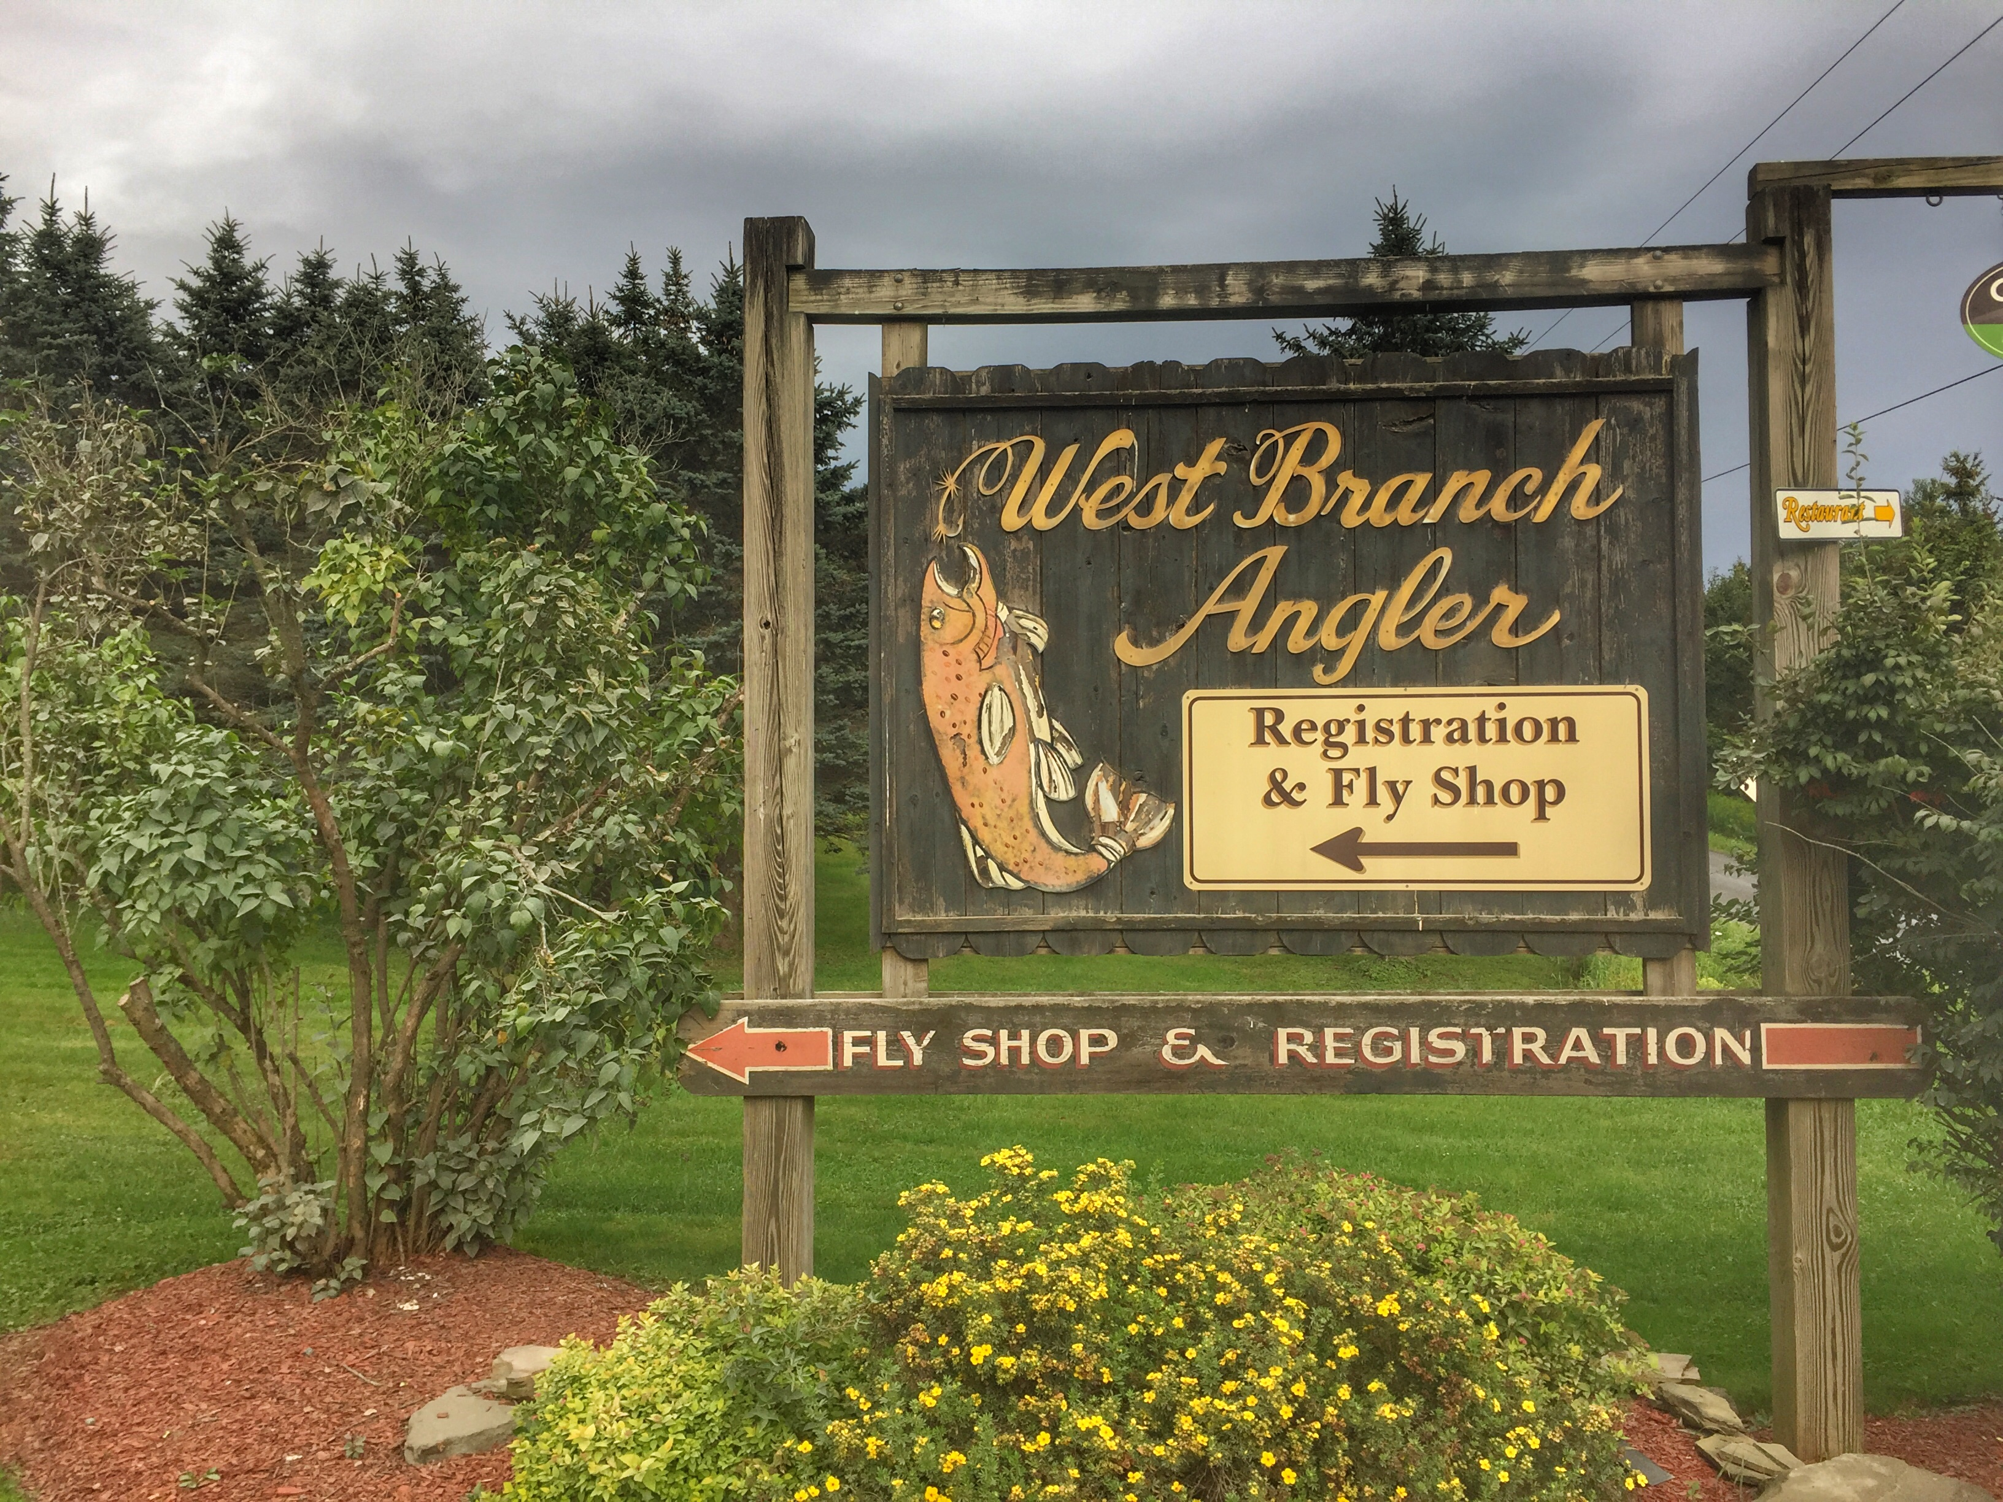
Context:
WBA Fishing Report

Slide 6
Competing intuitions:
I want less river discharge, for river accessibility and predictable holding features for fish
I want more river discharge, for fish and insect habitat—health for the resource

Slide 7
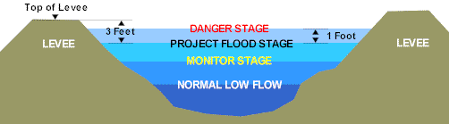
River dynamics:

Slide 8
Methodology:
Webscraped the WBA webpage for 3 years of reports
Created a dataframe of ‘Fishing Report Sentiment’ using the NLTK and stored that in a dataframe by date
Joined that data with the quantitative water data from .gov sources, by date

Slide 9

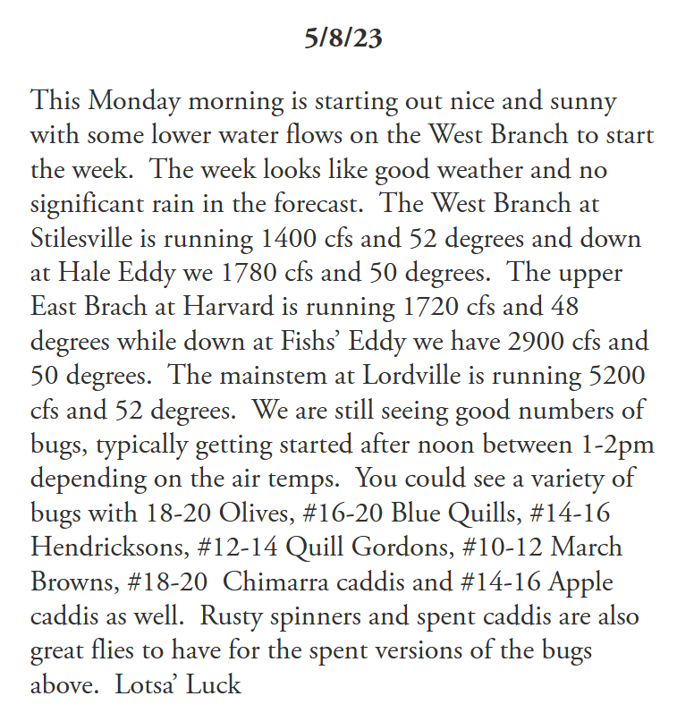
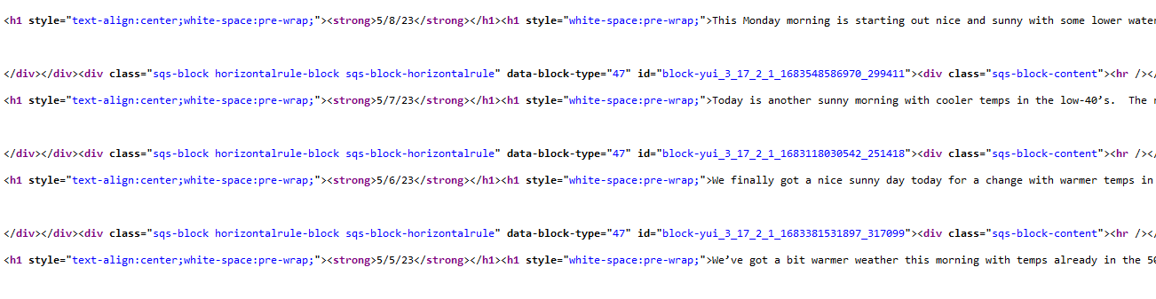
Dataset – West Branch Fishing Reports

Slide 10
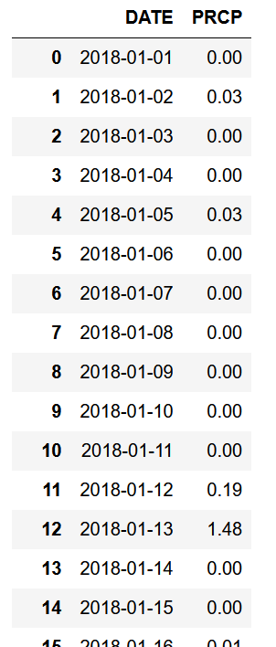
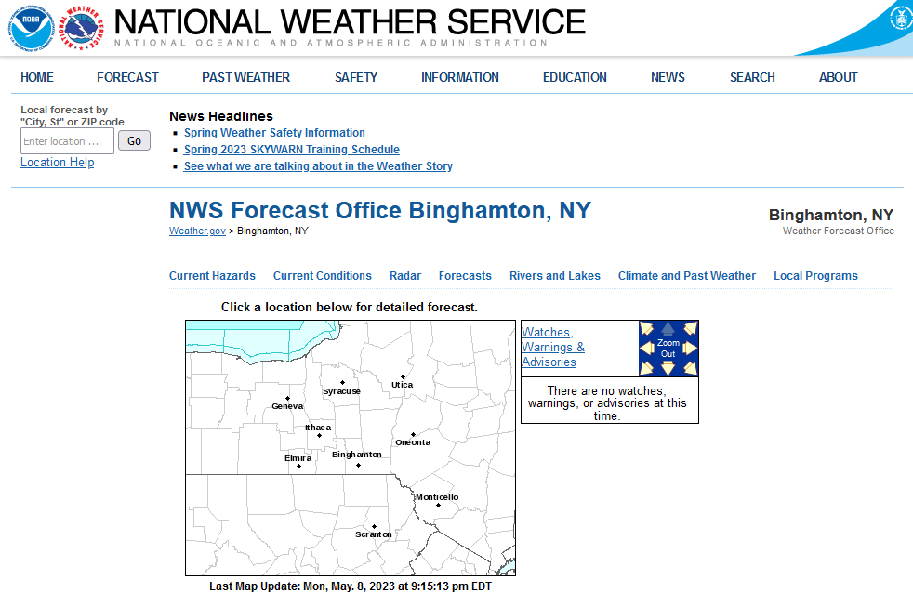
Dataset – Rainfall

Slide 11
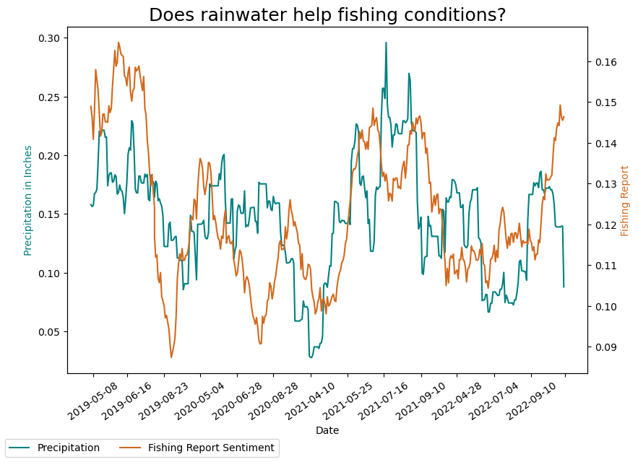

Slide 12
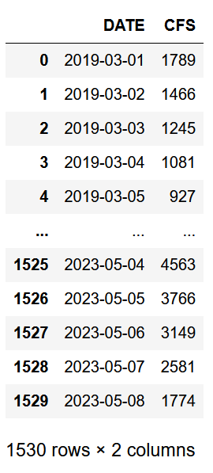
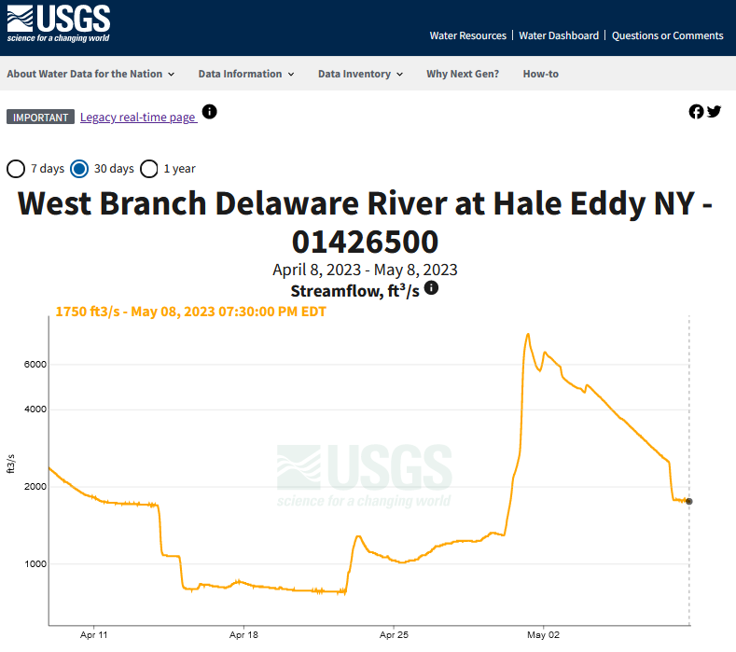
Dataset – Streamflow

Slide 13
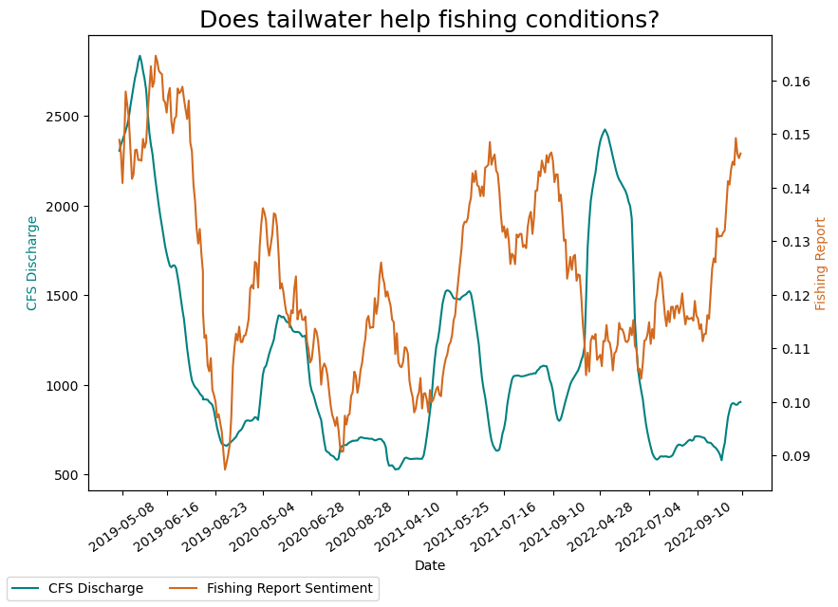

Slide 14
Conclusion:
We found that fishing reports by West Branch Angler Resort track well with water in the environment
That is for both rain, and tailwater discharge

Slide 15
Looking forward:
How does this trend apply to other branches of the Delaware River System?
Look at how the WBA Fishing Reports trends compared to the water temperature, and turbidity

Slide 16
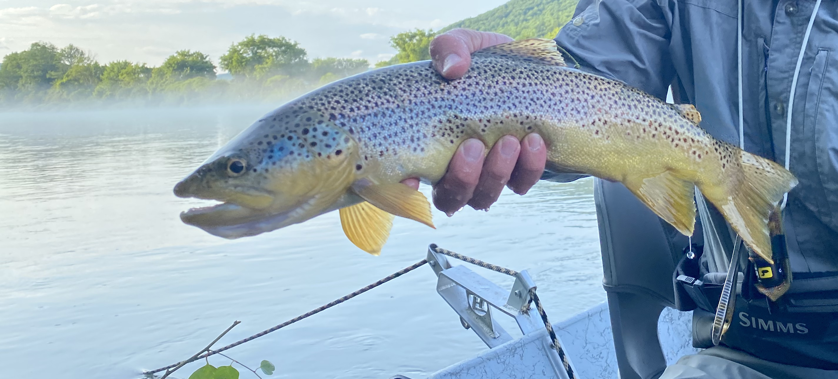
Thank you!

